Slide 1
17-3-25

Slide 2
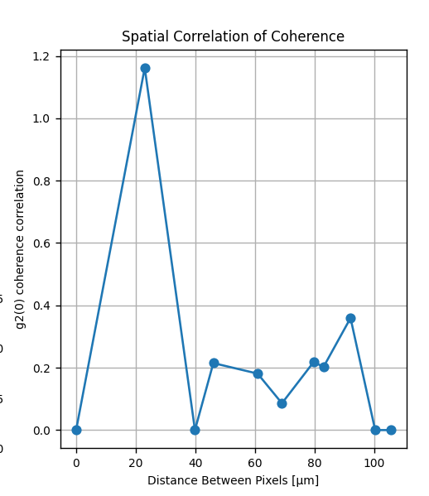
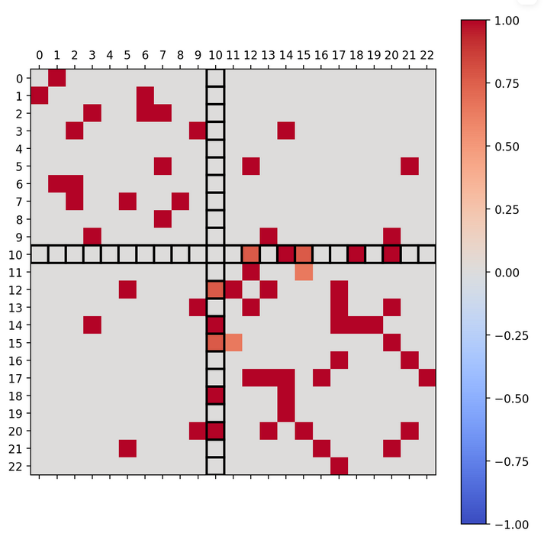
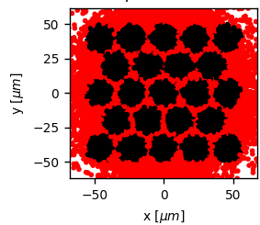
1 emitter
About 10.000 detected hits

Slide 3
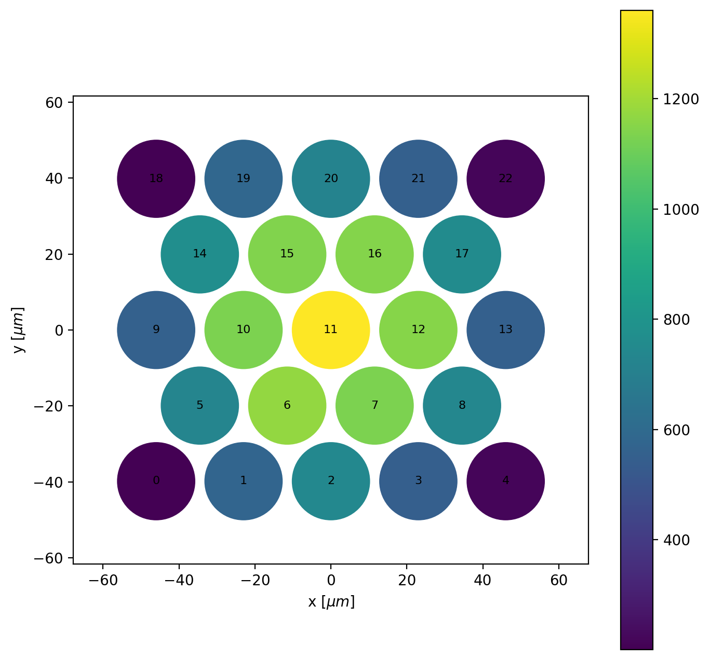
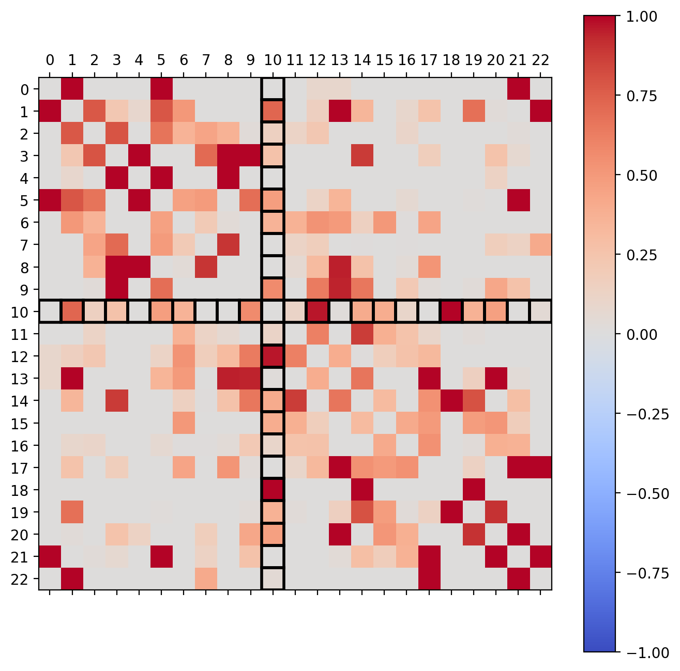
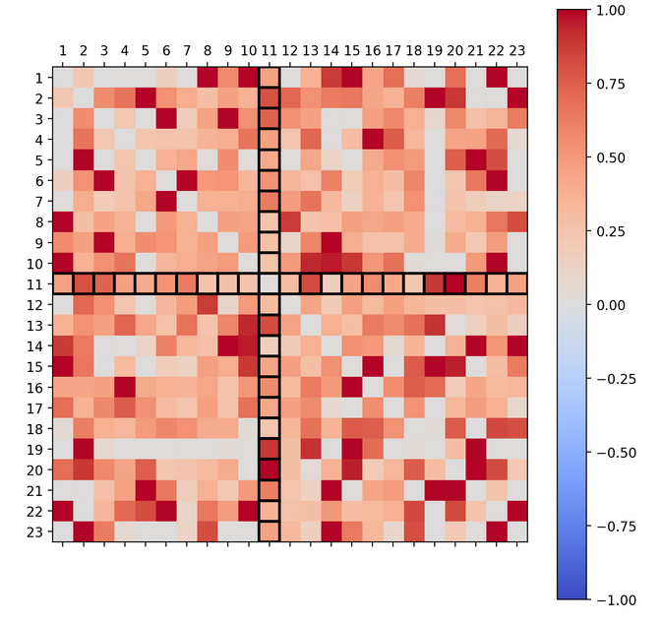
Binsize 0.1ns Binsize 0.5ns
- This shows 100 simulations’ average g2(0) values (normalised).
- For shorter deltaT (binsize), the correlation is more localized to pixels’ neighbours.
- Shorter deltaT => more fine-grained correlation calculation, less noise.
Square visible; this is due to higher intensity/more pixel counts in the centre
Close to diagonal high correlation. So, neighbouring pixels are correlated. Why?

Slide 4
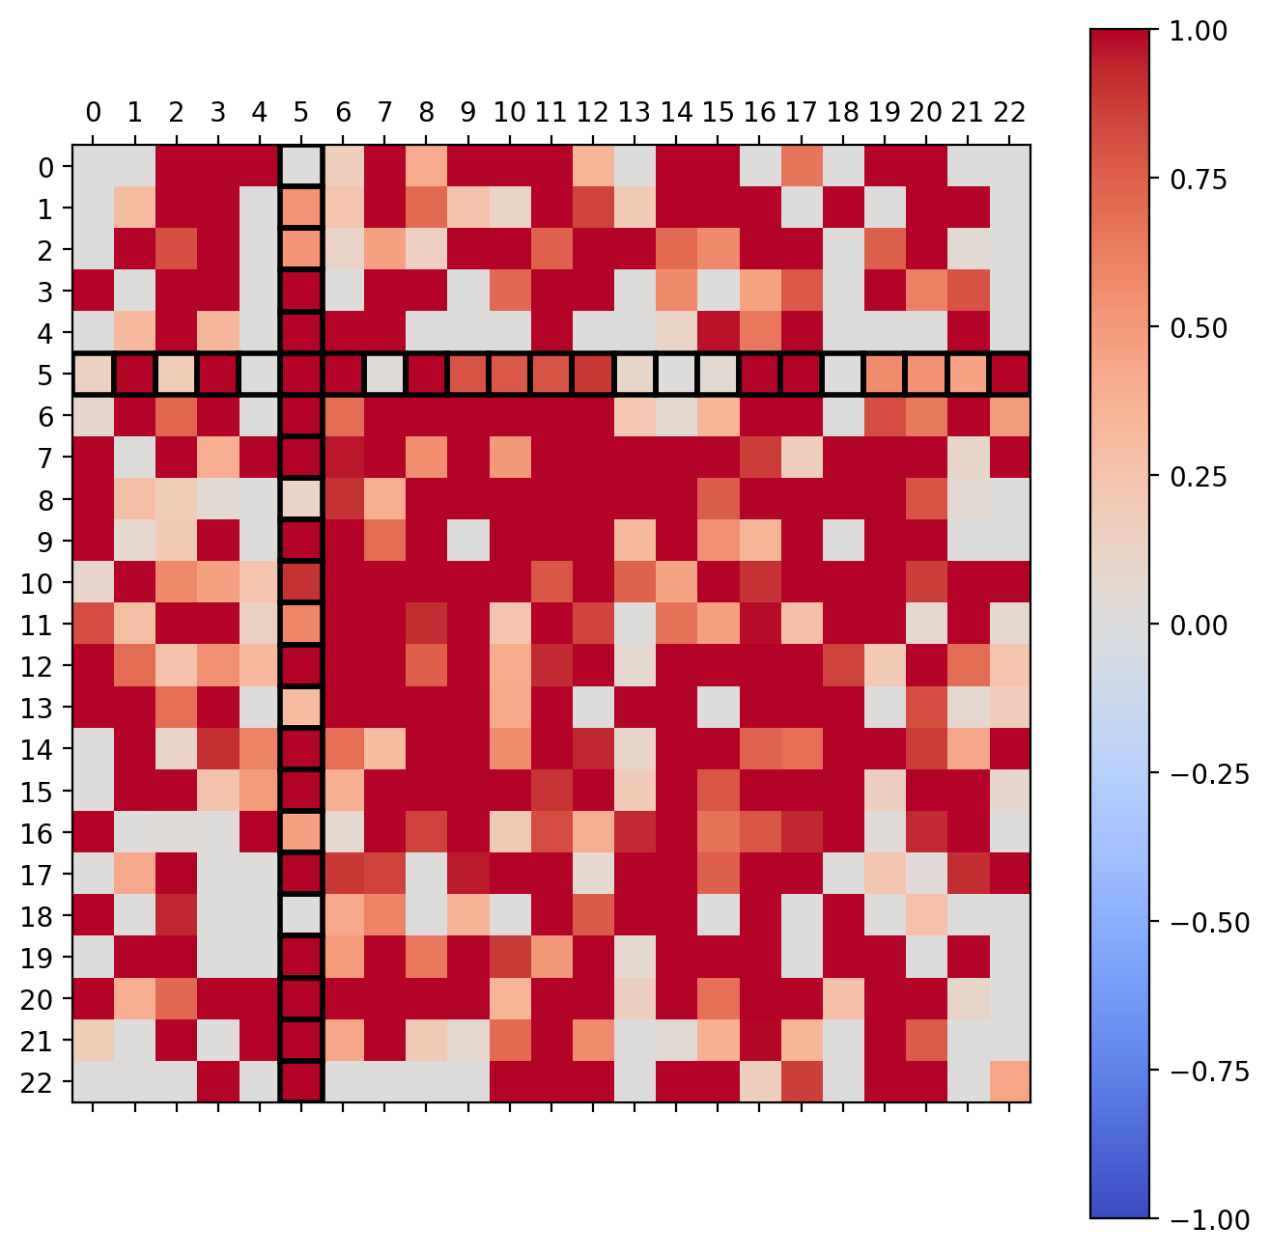
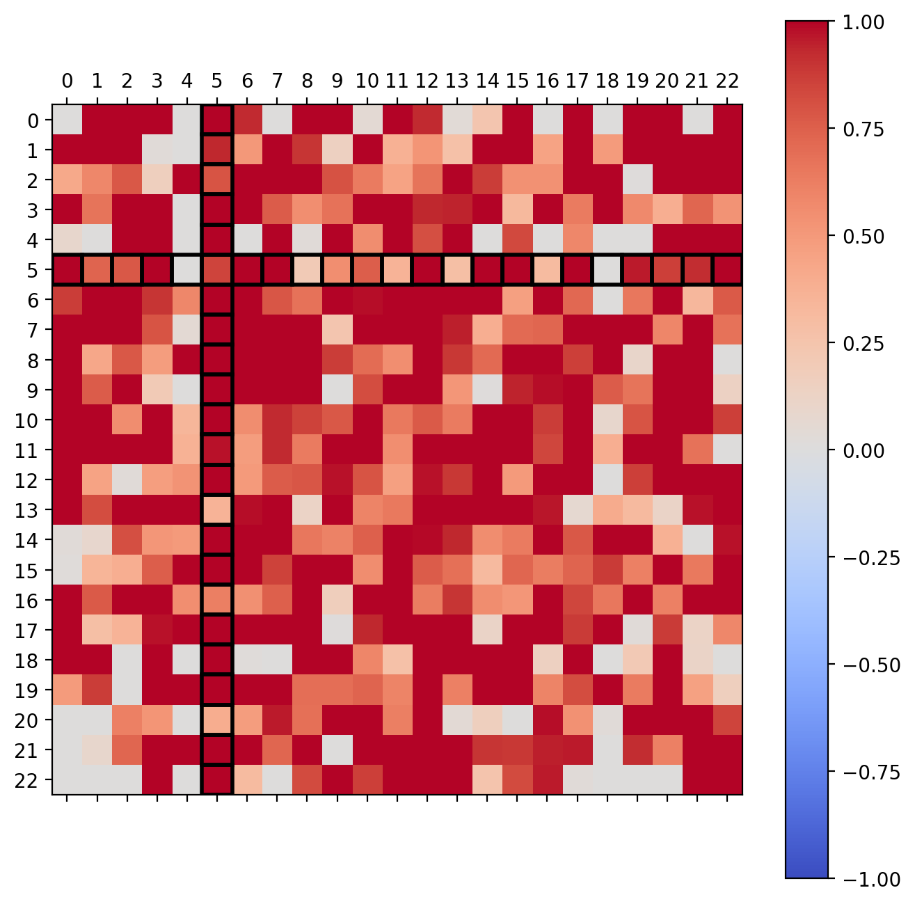
Average g2(5000ns)
High values everywhere.
g2(5000ns) => correlating photons with eachother that arrived at vastly different times, no information in there but high (random) correlations.
Can we extract information from relatively short delays > 0?
Binsize 0.1ns Binsize 0.5ns

Slide 5
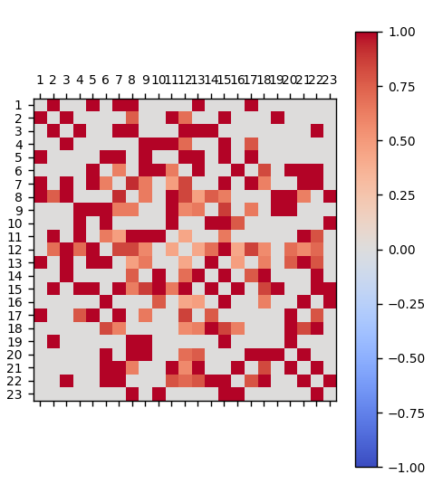
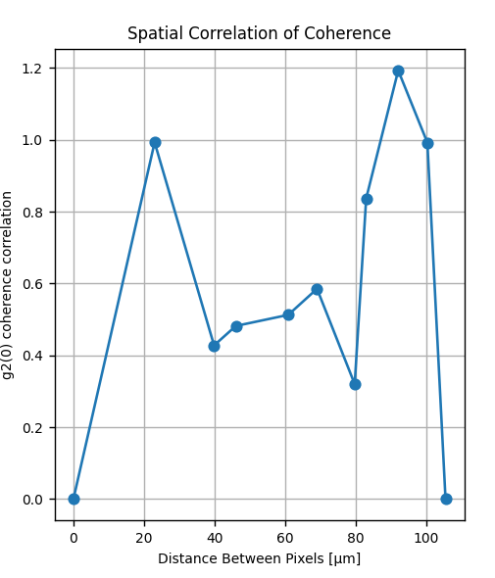
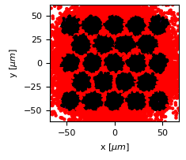
2 emitters
About 20.000 detected hits

Slide 6
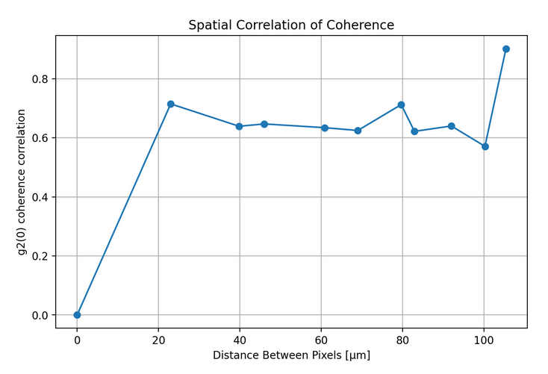
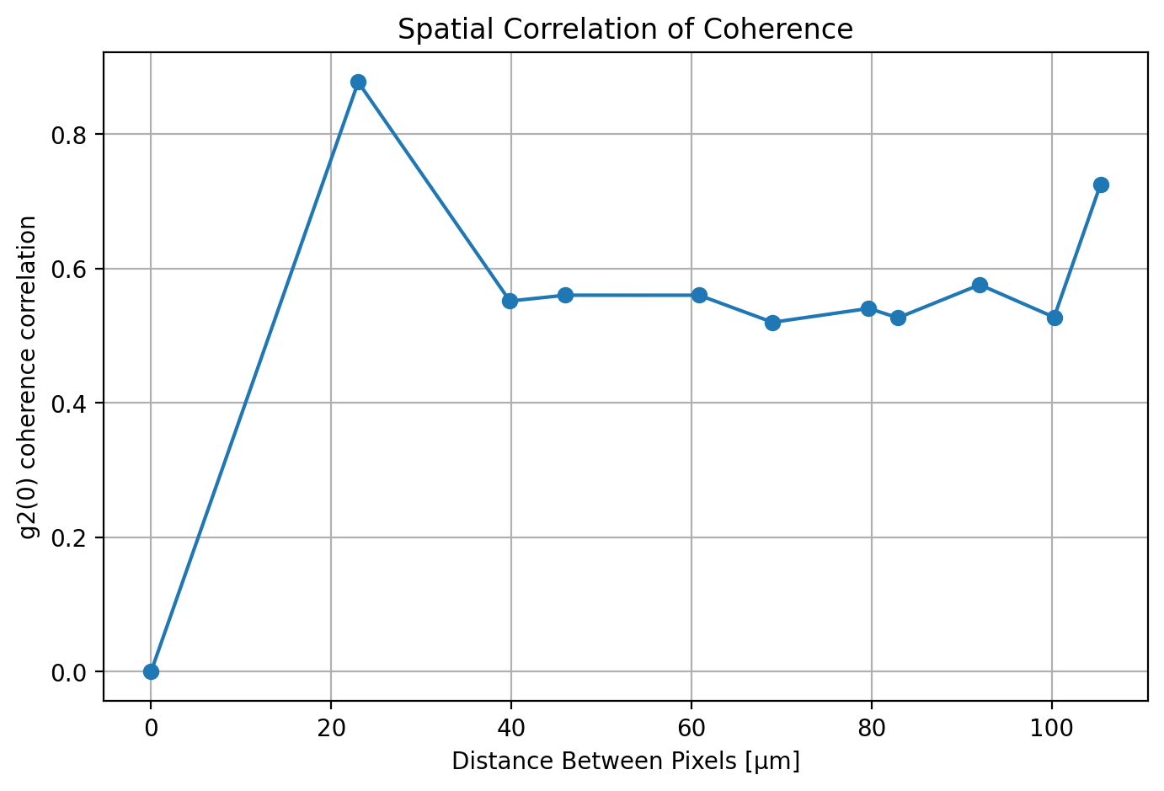
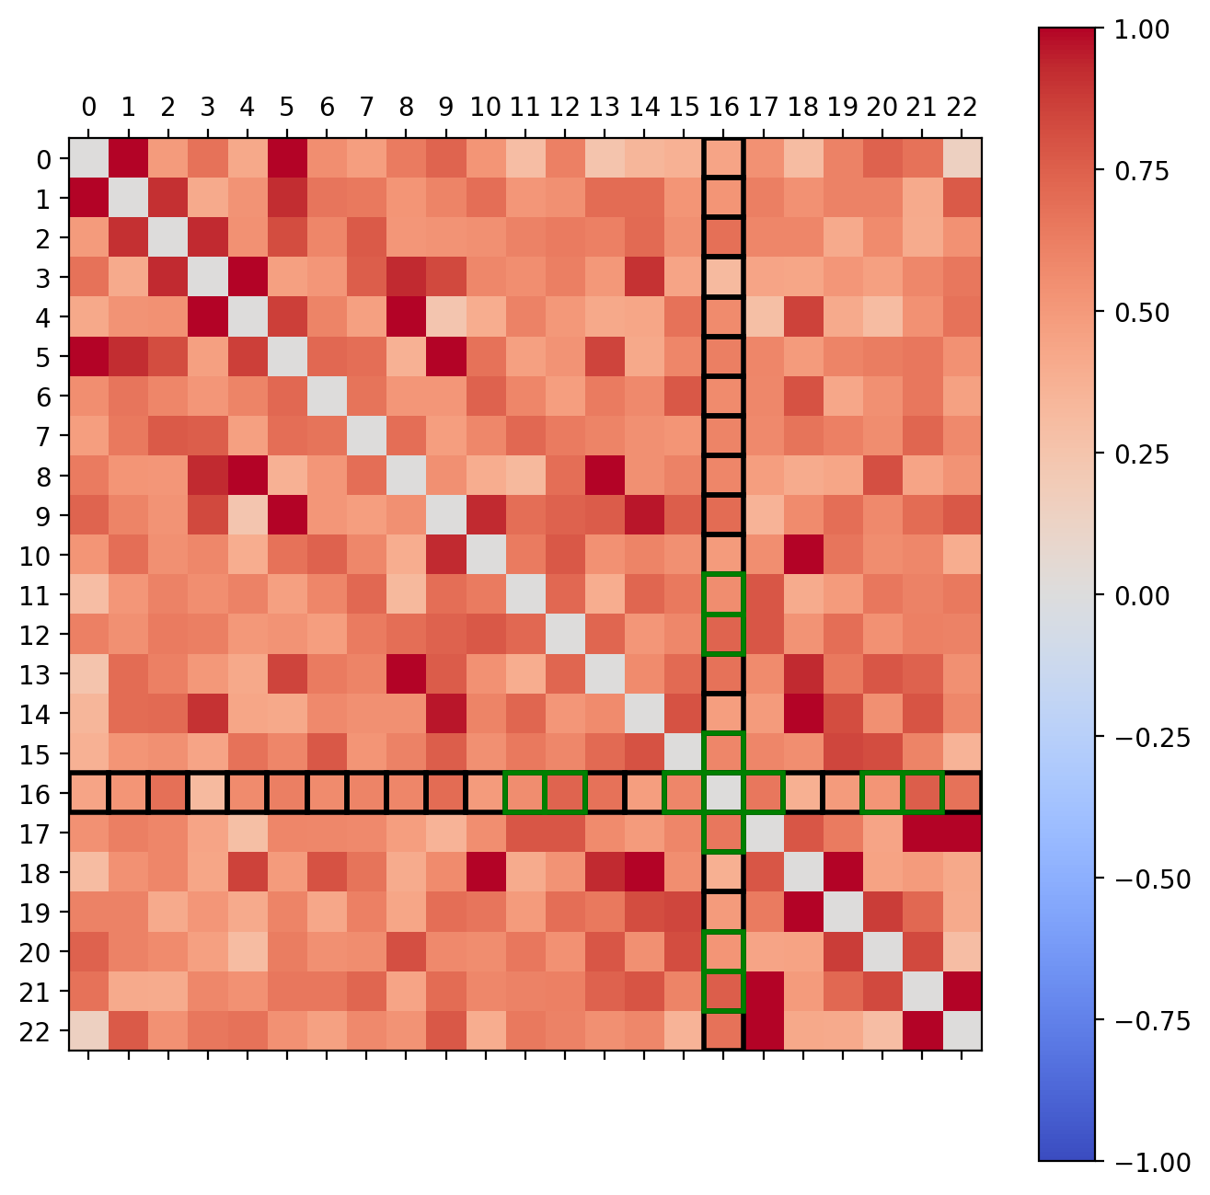
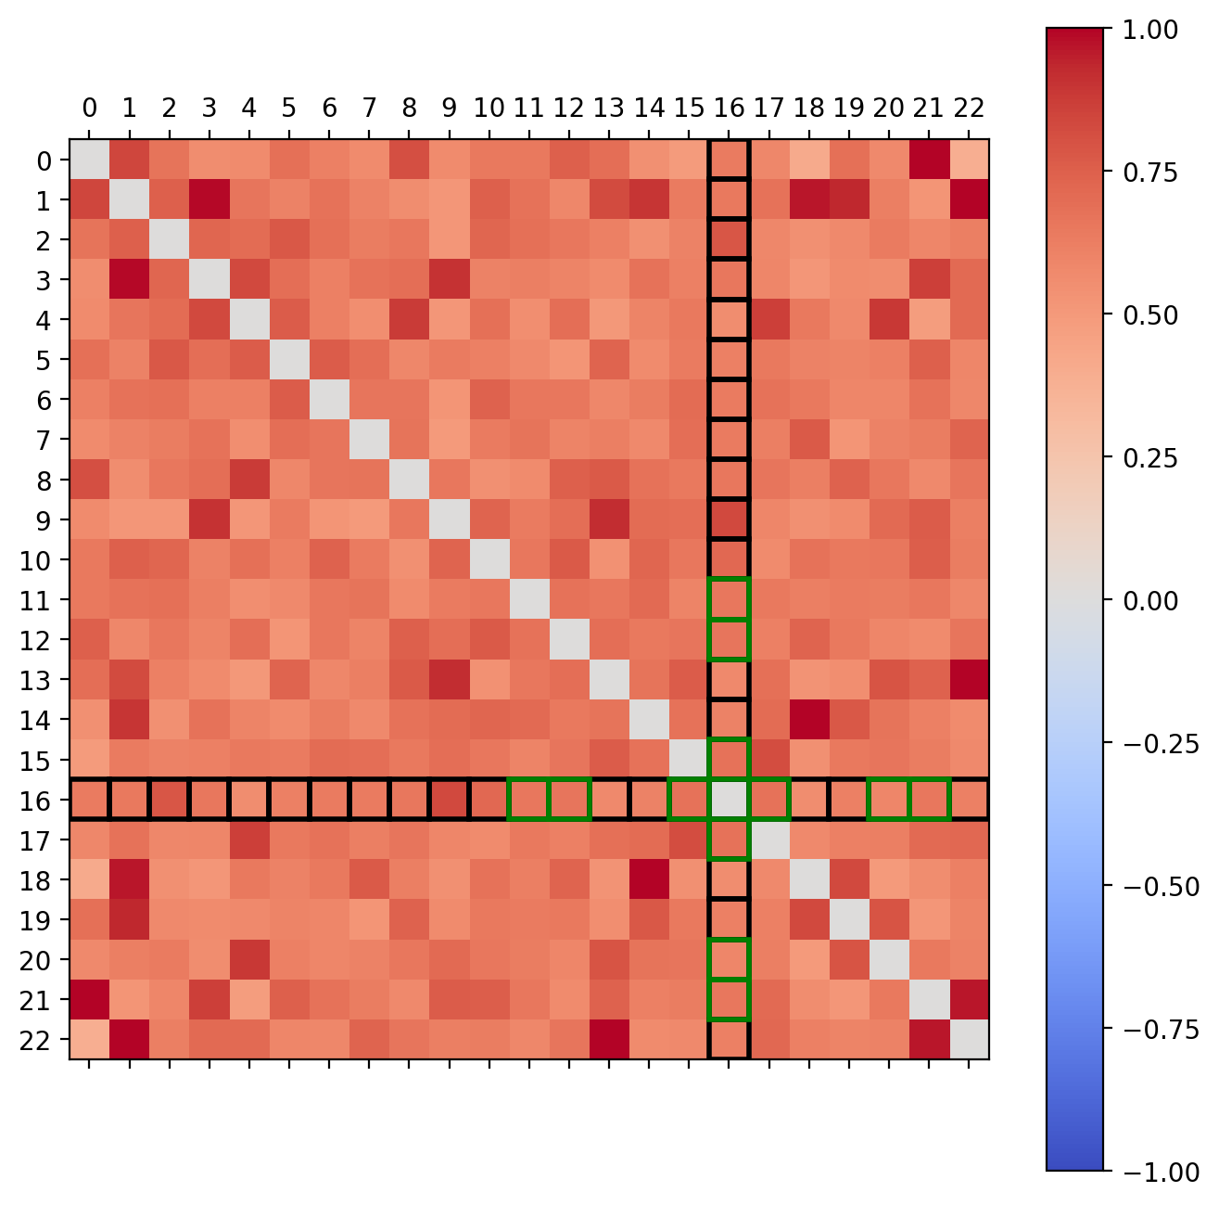
Average g2(0) of 100 simulations
Binsize 0.1ns Binsize 0.5ns

Slide 7
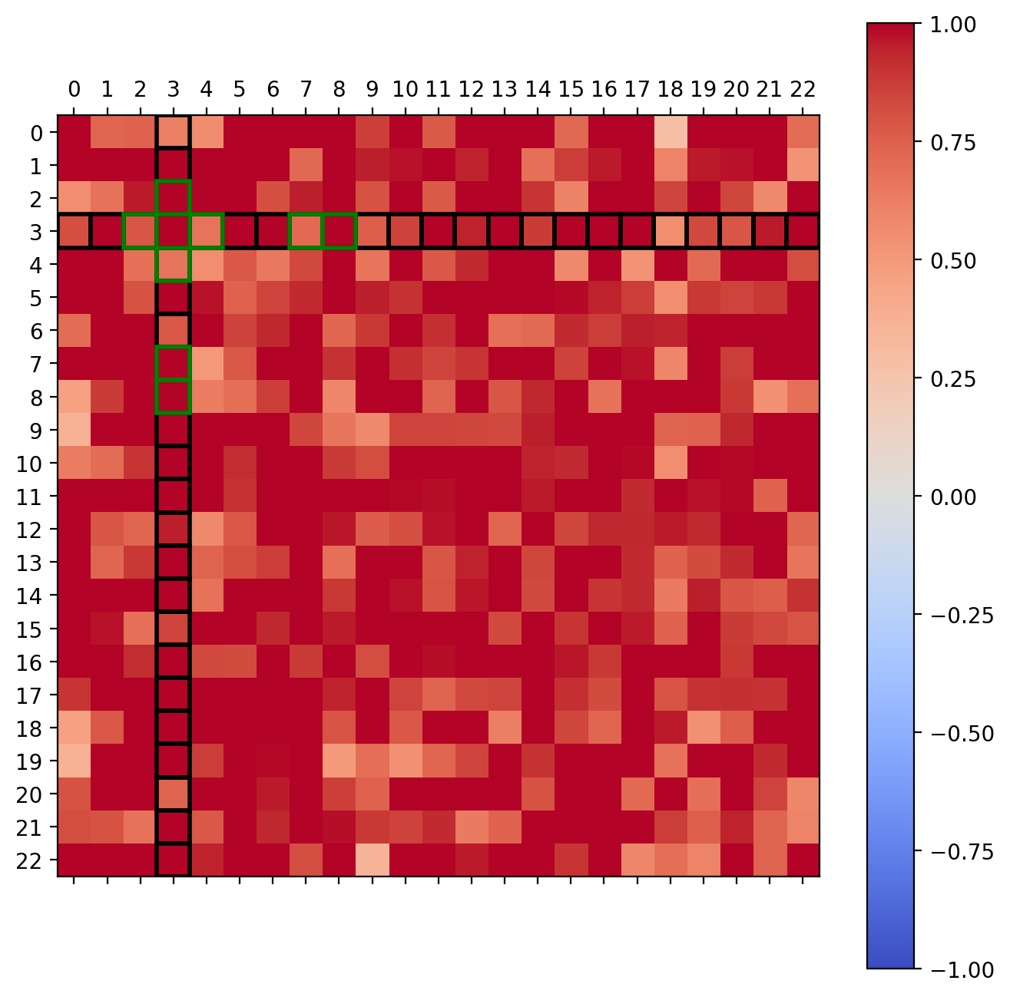
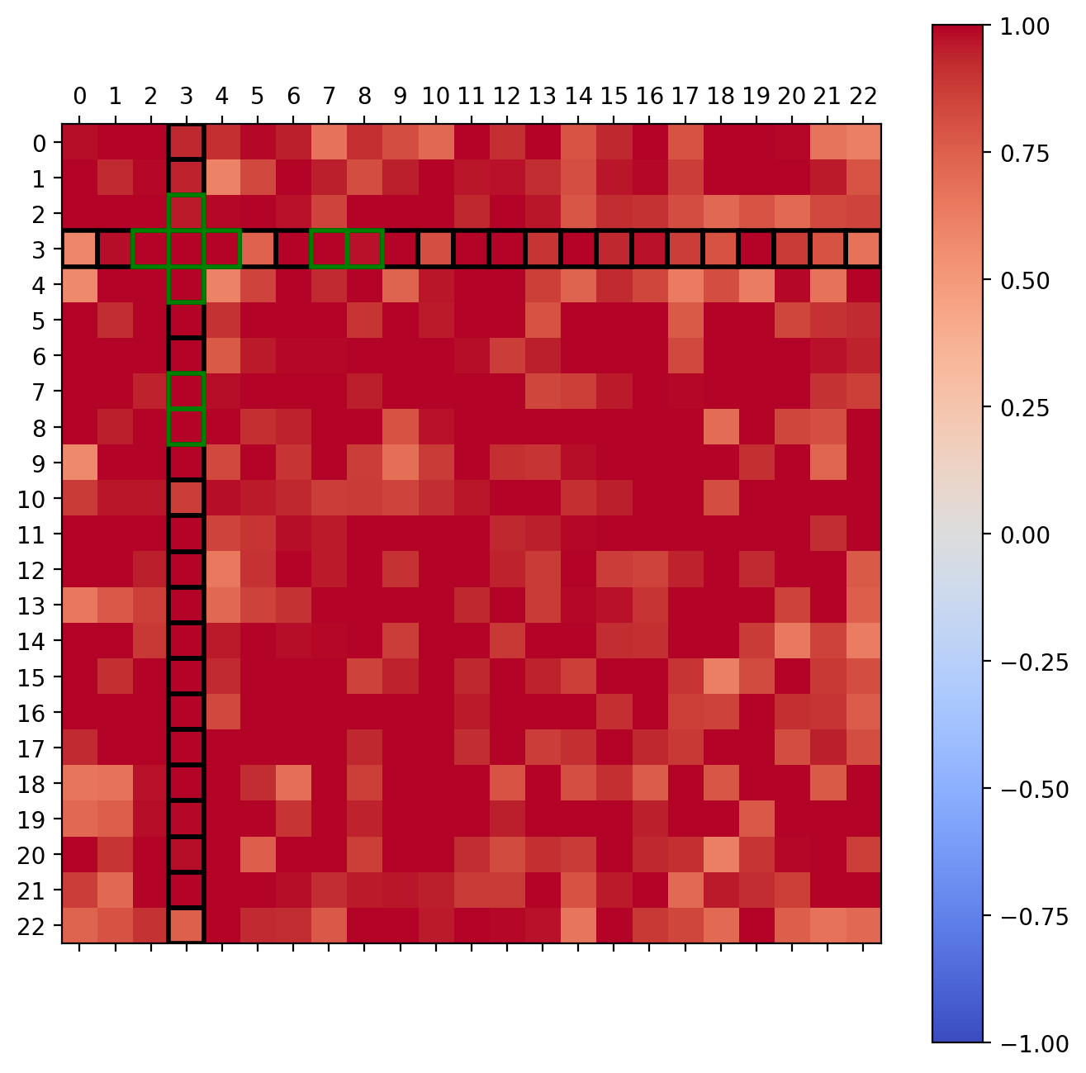
Average g2(5000ns)
Binsize 0.1ns Binsize 0.5ns

